Slide 1
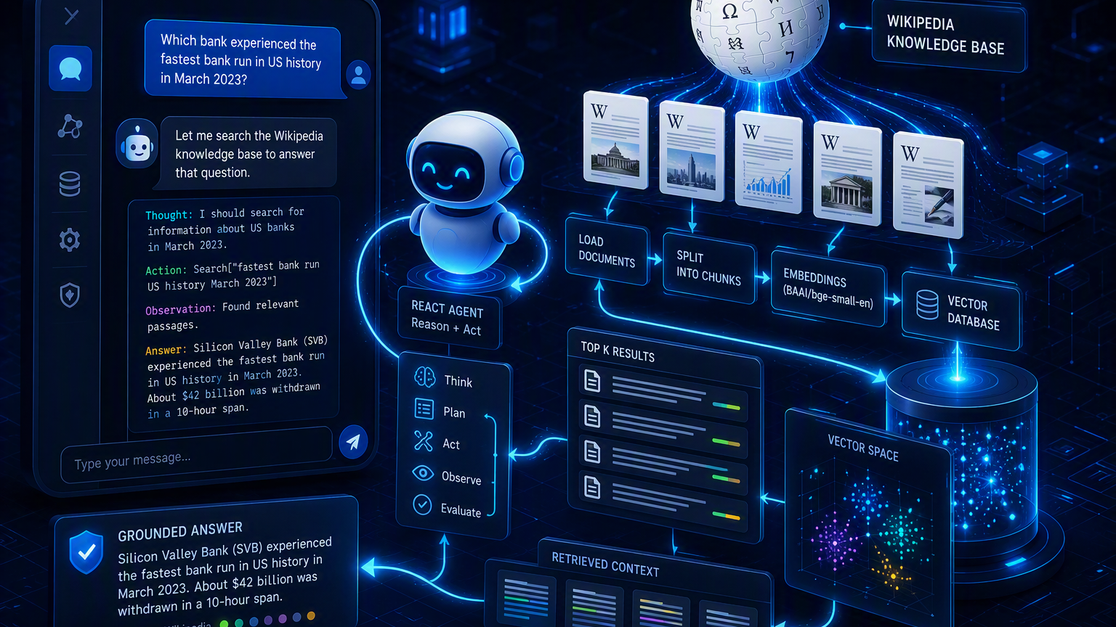
Wikipedia RAG + ReAct
Chat Assistant
From page ingestion to grounded answers with LlamaIndex, OpenAI, BGE embeddings, and Chainlit
Notes:
[Sources]
Visual on this slide was generated with Microsoft Copilot.
[/Sources]

Slide 2
What are we building?
A small but complete agentic RAG application
User experience
Core intelligence
Learning outcome
Select an OpenAI model
Choose one or more Wikipedia pages
Ask natural-language questions
Receive answers grounded in retrieved page content
RAG retrieves relevant chunks
The LLM synthesizes an answer
ReAct decides when to use the search tool
The loop observes results before responding
Understand ingestion and indexing
Build semantic retrieval
Wrap retrieval as an agent tool
Deliver a chat UI and test it end to end
Ground first, generate second
Memory line: RAG gives evidence. ReAct decides how to use it.
Notes:
[Sources]
User-provided project brief, Tasks 0–13.
Internal file: Enterprise_AI_RAG_MCP_Agents_Makro_Retail_Cheat_Sheet.docx.
[/Sources]

Slide 3
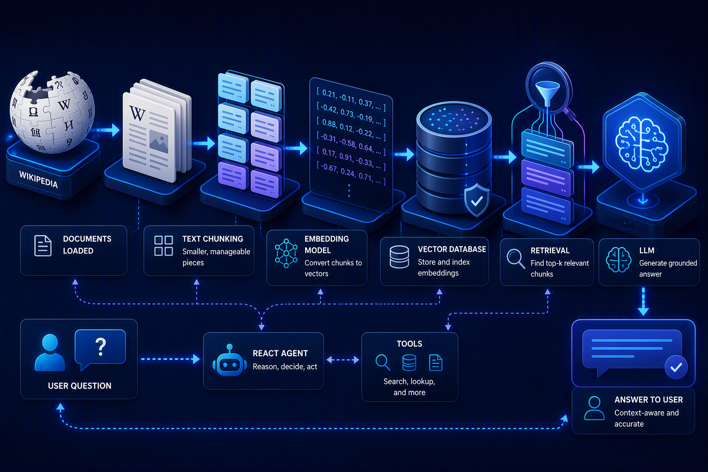
End-to-end architecture
Two connected flows: offline indexing and online question answering
INDEXING: pages → chunks → embeddings → vector index
QUERY: question → retrieve → reason → grounded answer
Notes:
[Sources]
Visual on this slide was generated with Microsoft Copilot.
User-provided project brief, Tasks 3–9.
[/Sources]

Slide 4
Project structure
Each Python module owns one clear responsibility
utils.py
index_wikipages.py
chat_agent.py
Loads OPENAI_API_KEY from .env or YAML
Validates that a key exists
Keeps credentials outside source code
Parses requested page titles
Downloads Wikipedia documents
Chunks text and creates embeddings
Builds VectorStoreIndex
Creates Chainlit settings
Turns index into a query engine
Wraps retrieval as a tool
Runs the ReAct chat interaction
01
02
03
Separation of concerns makes the project easier to test, explain, and troubleshoot.
Notes:
[Sources]
User-provided project brief, Tasks 0–6.
[/Sources]

Slide 5
Step 1: Secure configuration
Load the API key without hard-coding secrets
Why this matters
1 OPENAI_API_KEY=your_new_key_here
A leaked key can create unauthorized usage and cost. Keep `.env` out of Git and rotate any exposed key.
1 from dotenv import load_dotenv
2 import os
3
4 load_dotenv()
5
6 def get_apikey():
7 key = os.getenv("OPENAI_API_KEY")
8 if not key:
9 raise ValueError("Key not found")
10 return key
Correct `.env` syntax
Use `OPENAI_API_KEY=value`. Do not use a colon between the variable name and value.
Runtime behavior
Chainlit and the OpenAI wrapper read the environment variable when the application starts.
Notes:
[Sources]
User-provided project brief, Task 1.
[/Sources]

Slide 6
Step 2: Convert the request into page titles
Structured output prevents brittle string parsing
“Please index: London, Birmingham, New York”
["London", "Birmingham", "New York"]
Pydantic schema
Prompt template
OpenAI program
`WikiPageList` defines the expected list structure and validates the model output.
Instructions tell the model to extract only requested Wikipedia titles and avoid adding extras.
`OpenAIPydanticProgram` binds the prompt and schema to return predictable structured data.
Why use an LLM here? Users may phrase indexing requests in many different ways.
Notes:
[Sources]
User-provided project brief, Task 3.
[/Sources]

Slide 7
Step 3: Build the vector index
Semantic search starts by converting documents into searchable meaning
Load
WikipediaReader.load_data() retrieves the selected pages as documents.
Chunk
SentenceSplitter uses 150-token chunks with 45-token overlap.
Embed + index
BAAI/bge-small-en converts chunks to vectors; VectorStoreIndex stores them in memory.
Text → Vector → Similarity
Notes:
[Sources]
Visual on this slide was generated with Microsoft Copilot.
User-provided project brief, Tasks 4–5.
Internal file: Enterprise_AI_RAG_MCP_Agents_Makro_Retail_Cheat_Sheet.docx.
[/Sources]

Slide 8
Step 4: Create the retrieval engine
At question time, retrieve the most relevant chunks
1
2
3
4
Embed question
Similarity search
Top-K retrieval
Compact synthesis
Convert the user query into the same vector space.
Compare query vector with indexed chunk vectors.
Return the 10 most similar chunks.
Combine relevant evidence efficiently for the LLM.
similarity_top_k = 10
Notes:
[Sources]
User-provided project brief, Task 8.
[/Sources]

Slide 9

Step 5: Add the ReAct agent
The agent decides when retrieval is required and evaluates the observation
Reason
Interpret the question and decide whether Wikipedia evidence is needed.
Act
Invoke the `Wikipedia` QueryEngineTool with a focused search query.
Observe
Inspect the retrieved passages returned by the query engine.
Respond or continue
Answer when evidence is sufficient; otherwise repeat within iteration limits.
Notes:
[Sources]
Visual on this slide was generated with Microsoft Copilot.
User-provided project brief, Task 9.
Internal file: Agentic_AI_and_Multi_Agent_AI_Complete_Guide.docx.
[/Sources]

Slide 10
Step 6: Build the Chainlit experience
Settings initialize the knowledge base; messages invoke the agent
1. Chat starts
2. Settings update
3. User sends message
Display model selector
Display Wikipedia page input
Suggest the banking-crisis example
Read WIKIPAGES input
Create the in-memory index
Create ReAct agent
Store agent in the user session
Read `message.content`
Call agent.chat asynchronously
Render the final answer
Handle setup or run errors
Session storage avoids sharing one user’s active index with another user.
Notes:
[Sources]
User-provided project brief, Tasks 7 and 10–11.
[/Sources]

Slide 11
Run and troubleshoot
Use a compatible environment, then validate each layer independently
1 python3.11 -m venv venv
2 source venv/bin/activate
3 pip install -r requirements.txt
4 python utils.py
5 python index_wikipages.py
6 chainlit run chat_agent.py
Issue: Python 3.13 + older Chainlit
Use Python 3.11 for this pinned learning stack. The observed `CodeSettings`/Pydantic error occurs before application code runs.
Issue: terminal appears stuck
The indexing script is waiting for a page request. Enter `Please index: India` and press Return. Use Ctrl+C to cancel, not Ctrl+Z.
Issue: key not found
Confirm `.env` is in the project folder and uses `OPENAI_API_KEY=value`.
Test order: key → indexing → web UI
Notes:
[Sources]
User-provided terminal output and troubleshooting context from this conversation.
[/Sources]

Slide 12
Demo: 2023 United States banking crisis
A small evaluation set tests factual retrieval and grounded synthesis
SVB run
First Republic
Silvergate
$42B withdrawn in 10 hours
Closed and sold to JPMorgan Chase
90% crypto-related deposits
DFPI action
Signature Bank
Signet
Seized SVB; FDIC receivership
Second-largest crypto banking provider
Payment network opened in 2019
Correctness + faithfulness + latency
Notes:
[Sources]
User-provided project brief, Task 13.
[/Sources]

Slide 13
How to evaluate and improve
A working demo is only the beginning of a production-quality RAG system
Retrieval quality
Answer quality
Operations
Hit rate / Recall@K
Chunk relevance
Embedding choice
Metadata filters
Hybrid retrieval and reranking
Factual correctness
Faithfulness to evidence
Source completeness
Unanswerable-question behavior
Human QA feedback
Latency by stage
Token and API cost
Index freshness
Error and retry rates
Security and secret management
Production mindset: bad retrieval gives bad answers. Measure the pipeline, not only the final response.
Notes:
[Sources]
Internal file: Enterprise_AI_RAG_MCP_Agents_Makro_Retail_Cheat_Sheet.docx.
Internal file: Course Outline_Agentic AI Systems & Optimization Course_CMKL University.pdf.
[/Sources]

Slide 14
Key takeaways
Remember the project as a simple six-step story
1
Configure
2
Ingest
3
Index
Load the API key securely
Read selected Wikipedia pages
Chunk, embed, store vectors
4
Retrieve
5
Reason
6
Chat
Find the top relevant evidence
Let ReAct use the search tool
Deliver the answer through Chainlit
RAG grounds the answer. ReAct controls the action loop.
Notes:
[Sources]
User-provided project brief, Tasks 0–13.
[/Sources]

